Slide 1
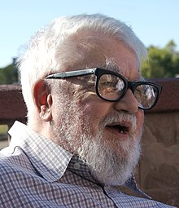
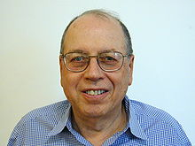
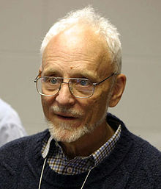
1959-1962
Kotok-McCarthy chess program
John McCarthy – MIT/Stanford
Alan Kotok
Elwyn Berlekamp
comparable to an amateur with about 100 games experience
Alpha-beta procedure to prune branches
Notes:
John McCarthy (September 4, 1927 – October 24, 2011) was an American computer scientist and cognitive scientist. McCarthy was one of the founders of the discipline of artificial intelligence.[1]

Slide 2
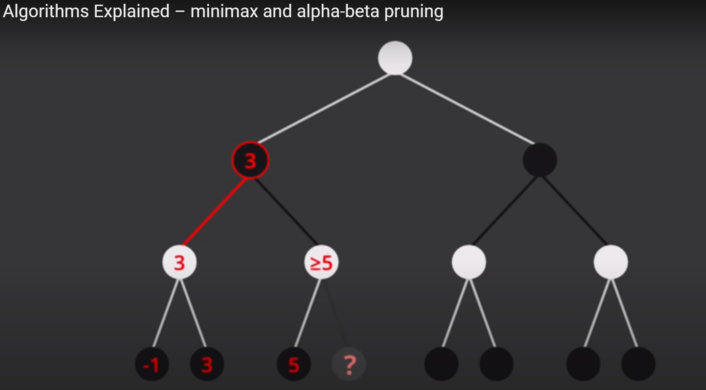

Slide 3
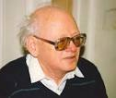
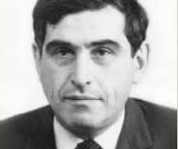
Soviet chess program
Georgy Adelson-Velsky
Alexander Kronrod
Notes:
Georgy Adelson-Velsky: Mathematician, he invented the AVL tree in 1962, in 1963 he headed computer chess program.
Alexander Kronrod: Soviet mathematician and computer scientist, best known for the Gauss-Kronrod quadrature formula which he published in 1964

Slide 4
Kotok-McCarthy VS Soviet program
November 22, 1967 – night months
2 draw
2 loss
Notes:
The forerunner of Kaissa, Kaissa became the first world computer chess champion in 1974 in Stockholm

Slide 5
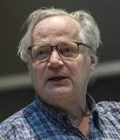
MAC HACK VI
Improved based on Kotok-McCarthy by Richard Greenblatt, an expert programmer at the AI Lab at MIT
Author is an expert chess player himself, incorporated excellent heuristics for choosing and evaluating moves.
the first program to play in tournaments against human chess players. 2 wins & 2 draws in 1967
Amateur human player level, rating 1450 on the U.S Chess federation rating scale.
Richard Greenblatt
Notes:
the first program to play in tournaments against human chess players – 2 wins and 2 draws. achieving a rating of
1450 on the U.S. Chess Federation rating scale, amateur human player.
an expert programmer at the AI Lab at MIT & an expert chess
player himself

Slide 6
Matches around 1970
first Association for Computing Machinery's computer chess tournament (computers against computers) in New York in 1970 – Winner is CHESS 3.0
CHESS 4.2 was beaten in an early round of the first World Computer Chess Championship tournament in 1974, winner and the world computer chess champion is Kaissa, whose forerunner is the Soviet program.
Notes:
CHESS 3.0 written by three students at Northwestern University in Illinois, David
Slate, Larry Atkin, and Keith Gorlen
CHESS 3.0 evaluated approximately 100 positions per second and played at the 1400 rating

Slide 7
Chapter 14 – Game Playing
Grand Masters
International Masters
National Masters
Experts
Class A
Class B
Class C
Notes:
1450 is Between B&C

Slide 8
Difference between computer and human in playing chess:
 | Knowledge | calculation
Human | Prodigious | Small amount
Computer | None or little rules | Tremendous calculation in large search for optimal maneuver
Notes:
the late 1960s through the mid-1970s, saw computer chess
programs gradually improving from beginner-level play to middle-level play

